Slide 1
The Chef Server

Slide 2
Refer to the Chef Fundamentals Linux - Introduction

Slide 3
Hosted Chef
More easily manage multiple nodes
Create a hosted Chef Account
Retrieve the organization key, personal key, and configuration file
Configure our chef-repo to communicate with the Chef Server
Validate the ability to connect to that server

Slide 4
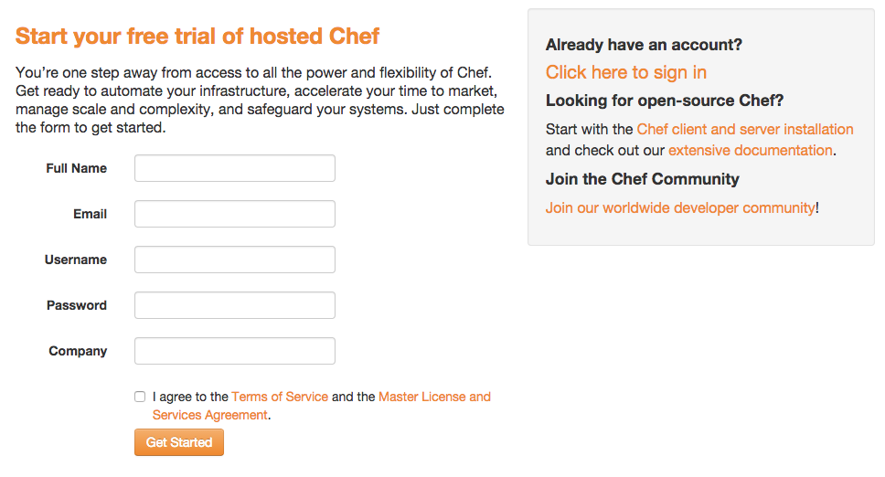
Visit http://manage.chef.io
Screenshots of setting up an account

Slide 5
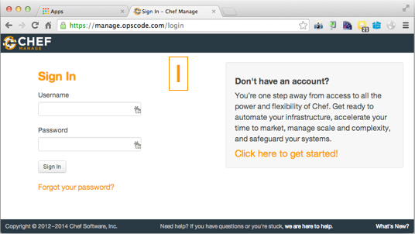
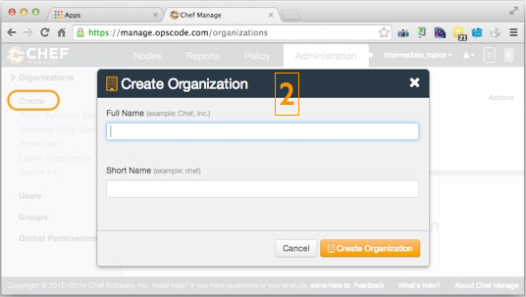
Sign in and Create and Org

Slide 6
Hosted Chef
More easily manage multiple nodes
Create a hosted Chef Account
Retrieve the organization key, personal key, and configuration file
Configure our chef-repo to communicate with the Chef Server
Validate the ability to connect to that server

Slide 7
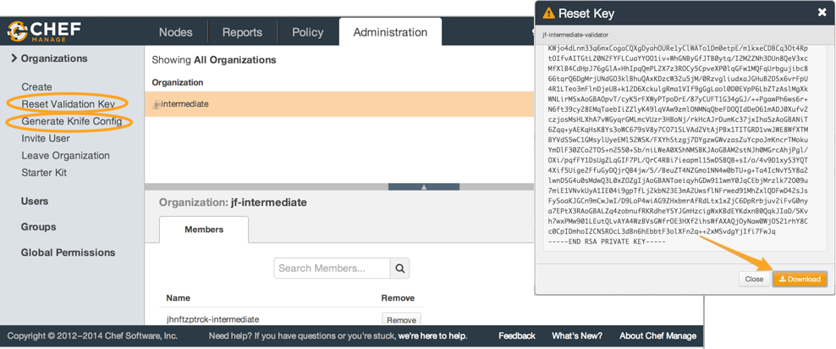
Get Your Org Key and Config

Slide 8
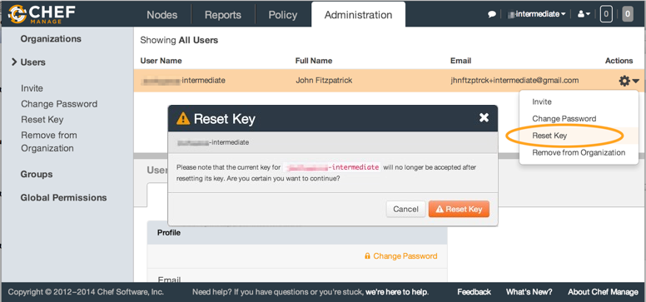
Get Your User Key

Slide 9
Hosted Chef
More easily manage multiple nodes
Create a hosted Chef Account
Retrieve the organization key, personal key, and configuration file
Configure our chef-repo to communicate with the Chef Server
Validate the ability to connect to that server

Slide 10
Copying Our Credentials into the Repo
$ cd chef-repo
$ mkdir .chef
$ mv ORGNAME-validator.pem .chef
$ mv USER.pem .chef
$ mv knife.rb .chef

Slide 11
Hosted Chef
More easily manage multiple nodes
Create a hosted Chef Account
Retrieve the organization key, personal key, and configuration file
Configure our chef-repo to communicate with the Chef Server
Validate the ability to connect to that server

Slide 12
Verify your connection to the Server
$ knife client list

Slide 13
Storing Cookbooks
The Chef Server will keep them safe!
Use knife to upload the cookbooks to the Chef Server

Slide 14
Uploading a Cookbook
$ knife cookbook upload setup

Slide 15
Show All Cookbooks on Server
$ knife cookbook list

Slide 16
Show a Specific Cookbook
$ knife cookbook show setup

Slide 17
Upload Cookbooks
Use knife to upload your other cookbooks
Use knife to verify that the cookbook was uploaded

Slide 18
Uploading a Cookbook
$ knife cookbook upload apache

Slide 19
Show All Cookbooks on Server
$ knife cookbook list

Slide 20
Show a Specific Cookbook
$ knife cookbook show apache

Slide 21
Now onto the Node
To node or not to node?
Use knife to bootstrap a node
Verify that the node has been added to our organization
Assign our recipes to the node's run list
Validate our website is still available on our node

Slide 22
Bootstrap a Node
$ knife bootstrap FQDN -x USER -P PASSWORD -N NODENAME

Slide 23
Show All Nodes
$ knife node list

Slide 24
Show a Specific Node
$ knife node show NODENAME

Slide 25
Adding a Cookbook to a Node's Run List
$ knife node run_list add NODENAME "recipe[setup]"

Slide 26
Adding a Cookbook to a Node's Run List
$ knife node run_list add NODENAME "recipe[apache]"

Slide 27
Show a Specific Node
$ knife node show NODENAME

Slide 28
Visit the Nodes Website
$ curl FQDN
Or view the website in the browser

Slide 29
Discussion
What questions can we help you answer?

